Slide 1
Computer Numerical Control
Computer Numerical Control or CNC is an advanced form of the NC system where the machine control unit is a dedicated microcomputer instead of a hard-wired controller, as in conventional NC.
CNC has evolved during the rapid improvements of the computer technology. The advent of Microprocessor, from the 1970s have helped in quick advancements in the Computer Technology and is in turn adapted in modern CNC Technology. Today’s CNC controller has latest features like high speed of operation, large memories, bus architectures, improved servos, etc.
CNC Technology has powered the machine Tool industry today. It is used in majority of machine tools like machining centers, turning centers, grinders, lathes, drilling machines, etc.

Slide 2
Elements of a CNC System
A CNC System consists of the following elements:
Input Device
MCU or Machine Control Unit
Machine Tool
Driving System
Feedback devices
Display Unit

Slide 3
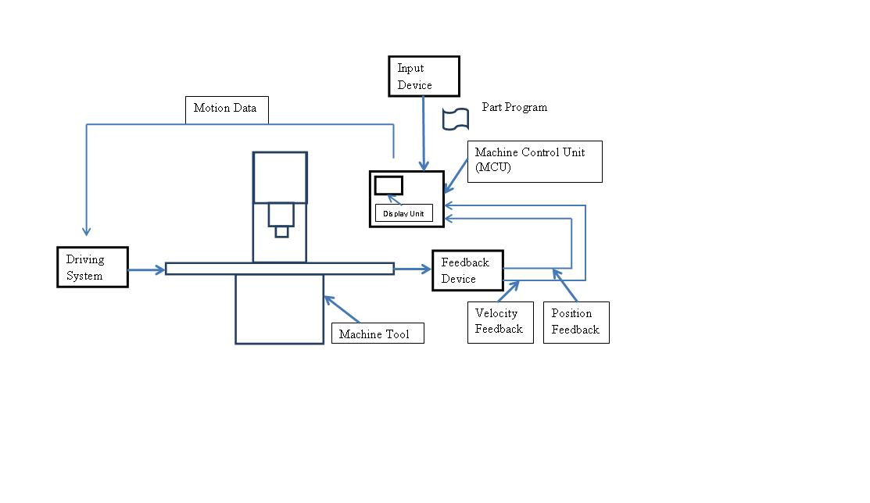
Elements of a CNC System

Slide 4
Input Device:
Through input device, part program is entered into CNC control or MCU (Machine Control Unit). Various input devices are as follows
  USB ( Universal serial Bus) : USB flash drives transfer data to the control
  Serial communication: A serial communication port connects computer system and CNC machine tool through an interface called RS-232. Through RS-232 cable , data is transferred from computer to CNC machine
  Ethernet Communication: Here, CNC machines are provided with Ethernet Card support. An Ethernet cable transfers data from the computer to CNC machine
  Conventional Programming: A built-in intelligent software inside the controller enables the operator to enter step by step data
MCU or Machine Control Unit:
It is the heart of the CNC system. It consists of the following components
  Central Processing Unit (CPU) : It comprises of
    A control section that retrieves data from memory and generates signals which in turn activates all MCU components
    An ALU (Arithmetic Logic Unit) that performs integer arithmetic operations and logical operations
    Intermediate Access Memory: This holds the data and programs temporarily that is required at that instant by the control section

Slide 5
MCU …………contd.
  CNC Memory: The memory of CNC is divided into
    Main memory. This consists of
      Read only Memory (ROM) – stores Operating System (OS) software and machine interface programs
      Random Access Memory (RAM) – stores part programs
    Secondary Memory – such as Hard Disks which is used to store large programs and can be used by main memory when required
  Input / Output (I/O) Interface :
  I/O interface establishes communication between the machine operator, the components of CNC system and other connected computers
  Machine Tool Controls:
  A machine tool consists of various axes e.g. X,Y,Z,A,B,C and a spindle which rotates at the designed RPM. Machine Tool Control hardware components in the MCU control the position and velocity of each of the axis and rotational speed of the spindle
  Sequence controls for auxiliary functions:
  Certain auxiliary functions like coolant control, emergency stop, tool changing function etc. are also carried out under part program controls

Slide 6
Machine Tool:
The essential parts of the machine tool include the machine table, machine slide, the driving lead screw, ball screw, rigid and heavy machine structure, automatic tool changing system, spindle and spindle drive system, chip removal system etc.
Driving System:
A driving system essentially is made up of amplifier circuits, drive motors and ball-led screws. The commonly used types of electrical motors include DC Servo Motor, AC Servo Motor, Stepper Motor and Linear Motor
Feedback Devices:
For the accurate operation of a CNC machine , the positional values and speed of the axes needs to be continuously updated. This is done by feedback devices. There are two types of feedback devices
  Positional feedback devices
  Velocity feedback devices
Display Unit:
This device displays the current status of operation such as the spindle RPM, the running part program, the feed rate, position of the machine slide etc. It shows the graphic simulation of the paths taken by the tool. Any malfunction of the CNC system is also displayed as warnings. Other data e.g. machine parameters, logic diagram of program controller, error message and diagnostic data are also displayed

Slide 7
Advantages of CNC Machines
The accuracy and repeatability obtained is high. Many Aircraft parts are produced by CNC machines.
Complex shaped contours can be machined. E.g.- Turbine blades, impellers etc.
Can be easily programmed to handle variety of product styles.
High volume production compared to conventional machines.
Even lesser skilled or trained people can operate CNC machines unlike the conventional ones where highly skilled people are required.
CNC Machines can be used uninterruptedly without turning them off provided regular maintenance is done.

Slide 8
Advantages of CNC Machines
Avoids errors that were otherwise committed by humans operating conventional machines.
Since CNC machines can be programmed, one person may well take care of a number of CNC machines. This reduces the employees and hence costs are reduced.
Using CNC machines results in a safer work environment since the operator is not exposed to the machine area during machining.
CNC Machines can be upgraded to newer technologies by replacing the existing CNC Control with an advanced one.
Many CNC Machined can be linked together to a main computer. Programs can be downloaded to any connected CNC machines. This leads us to another type of NC concept called as the Direct Numerical Control (DNC).

Slide 9
Disadvantages of CNC Machines
A thorough programming knowledge is required by the operators or programmers. This again requires skilled programmer and hence the cost of labor can be high.
Cost of a CNC Machine is high compared to the conventional Machines Tools.
The spares of CNC Machines are relatively costlier than conventional Machines.
CNC Machines require air conditioned environment and/or a chiller unit. Thus extra costs are involved.

